Slide 1

Maine Women’s Fund
Zoom info session
July 22nd, 2025
Gloria Aponte C.
Community Partner
Photo credit: New Ventures- Trades for Me

Slide 2
About Maine Community Foundation
Founded in 1983, the Maine Community Foundation brings people and resources together to build a better Maine.
Values
Integrity: We earn trust by being honest and open in everything that we do.
Respect: We treat everyone with dignity and civility.
Stewardship: We manage the resources entrusted to us responsibly.
Equity: We promote just and fair access to opportunities for all people.
Collaboration: We work with others to achieve common goals.
To learn more about the foundation, visit mainecf.org.

Slide 3
Maine Women’s Fund Overview
Founded in 1988 at MaineCF
Organizations must meet criteria and eligibility
Transforming the lives of Women and Girls is the goal!
Two year grants -Max award: $15,000
Application due date: September 15, 2025 at 11:59pm

Slide 4
Maine Women’s Fund Criteria
Be located in Maine, defined as your organization has a Maine address
Serve women and girls in Maine as the primary recipients, defined as your organization offers two or more programs focused on women and girls
Serve women and girls from an underserved geography or population

Slide 5
Maine Women’s Fund Criteria
Focus on one or more of the following four focus areas:
  financial literacy,
  health education,
  leadership development, or
  policy/advocacy
Engage the people served in the design, delivery, evaluation, and/or leadership (board or staff) of the work

Slide 6
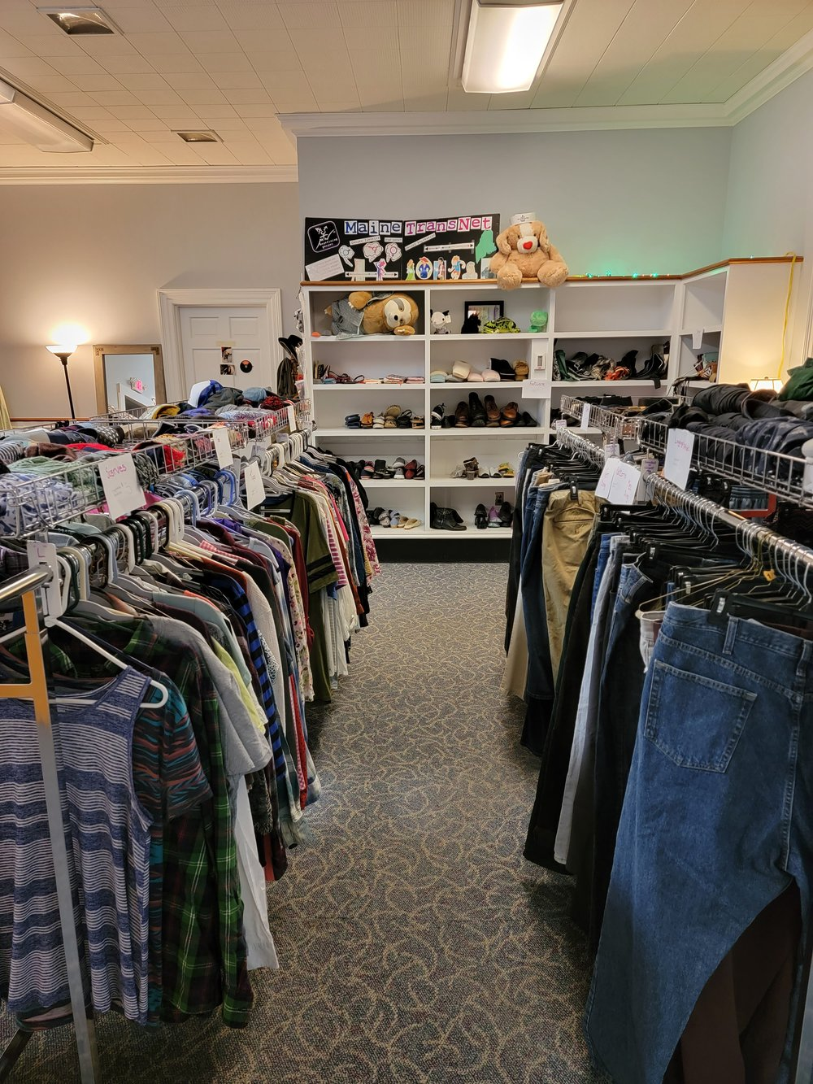
Maine Women’s Fund Grants
Two-year general support grants
$15,000 per year
Multi-year grantees will be selected every two years. This grant program will accept applications in 2025 and again in 2027.
Photo Credit: MaineTransNet- Safe Combinations Thrift

Slide 7
How are Grant Decisions Made?
Maine Women’s Fund Advisors read applications
General Support- Reviewers will:
  Focus on Criteria and
  Focus on Mission and your most important programs

Slide 8
Application Questions
Why does your organization need flexible, unrestricted funding right now?
How does your organization’s mission or purpose address the grant program criteria?
How does your organization know if it’s achieving your mission or purpose? How do you track results?
We involve the people we serve in (select all that apply):
  Design
  Delivery
  Evaluation
  Leadership

Slide 9
Application Questions
5. Describe the local, regional, and/or statewide impact of your organization’s work/programs.
6. Select the focus area most closely aligned with your organization’s mission or purpose: (select all that apply)
  Financial Literacy
  Health Education
  Leadership Development
  Policy and/or Advocacy

Slide 10
What the Maine Women’s Fund CAN NOT fund
For profit businesses
Regranting to a secondary grantee through a competitive process
Individuals
Political campaigns
Lobbying in the form of calls to action on a specific vote
Religious activities, including, but not limited to, religious services, promotion of religious beliefs, or activities that are restricted to church or religious group membership.

Slide 11

Attachments
All Applicants:
  List of Board members names
Only if:
  Working with a school
  Using a Fiscal Sponsor
Photo credit: In Her Presence

Slide 12
Maine Women’s Fund Grant Program
Date | Activity
September 15 | Application Due Date
Late September | Grant staff review
October 1-29 | Proposal review by advisors and donors
November | Grant decision meeting
December | Process decisions
December | Decisions e-mailed

Slide 13
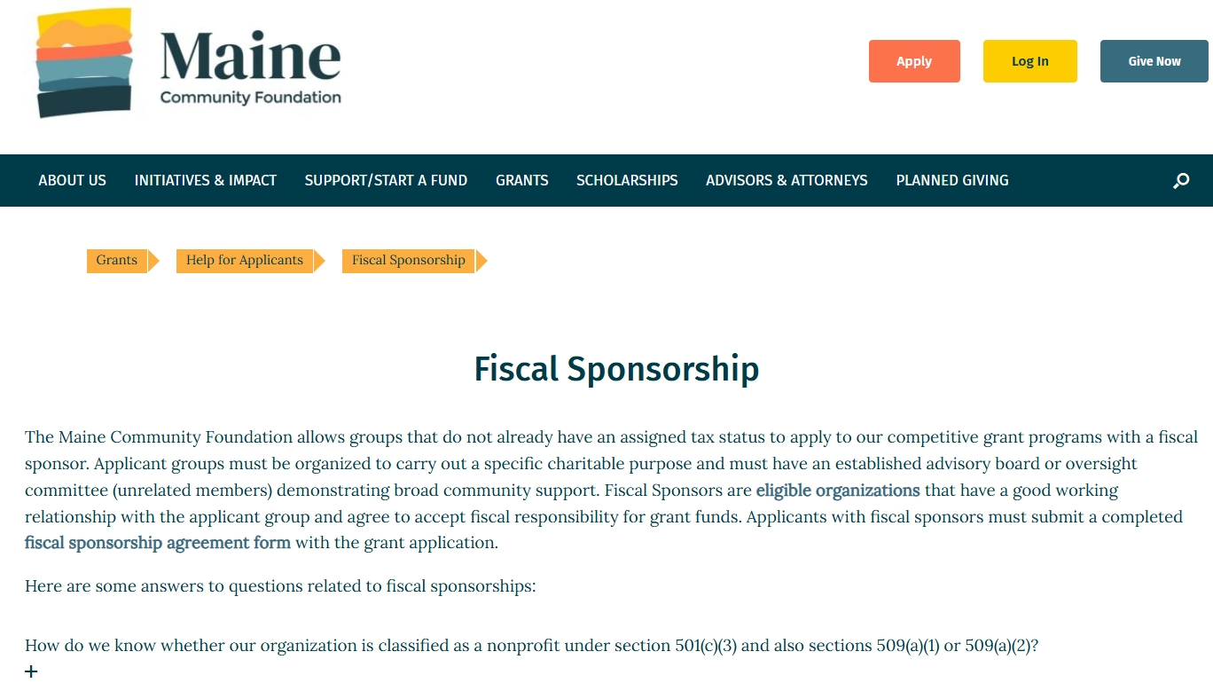
Online Resources

Slide 14
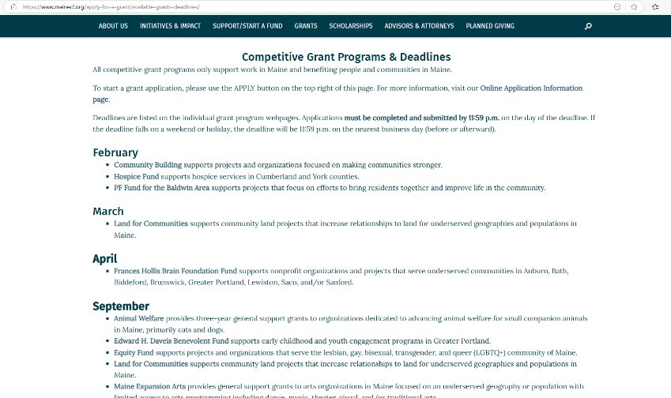
Online Resources

Slide 15
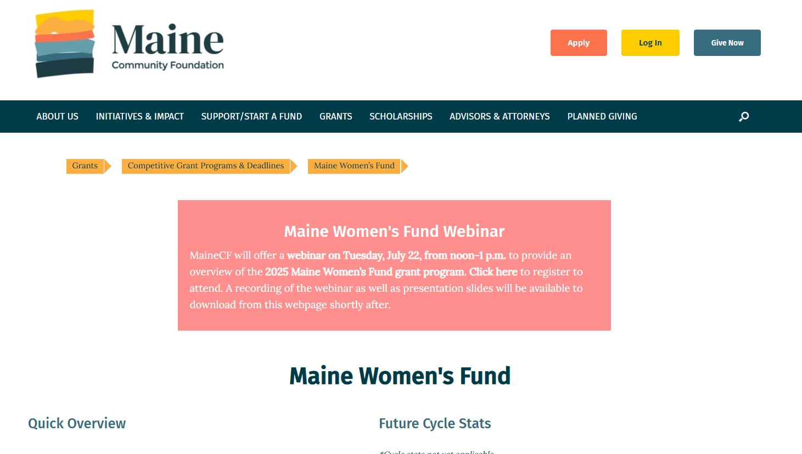
Online Resources & Application System

Slide 16
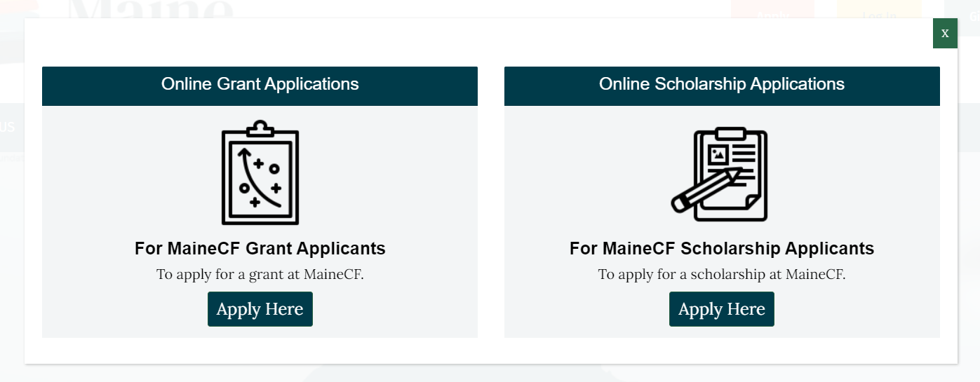
Online Application System

Slide 17
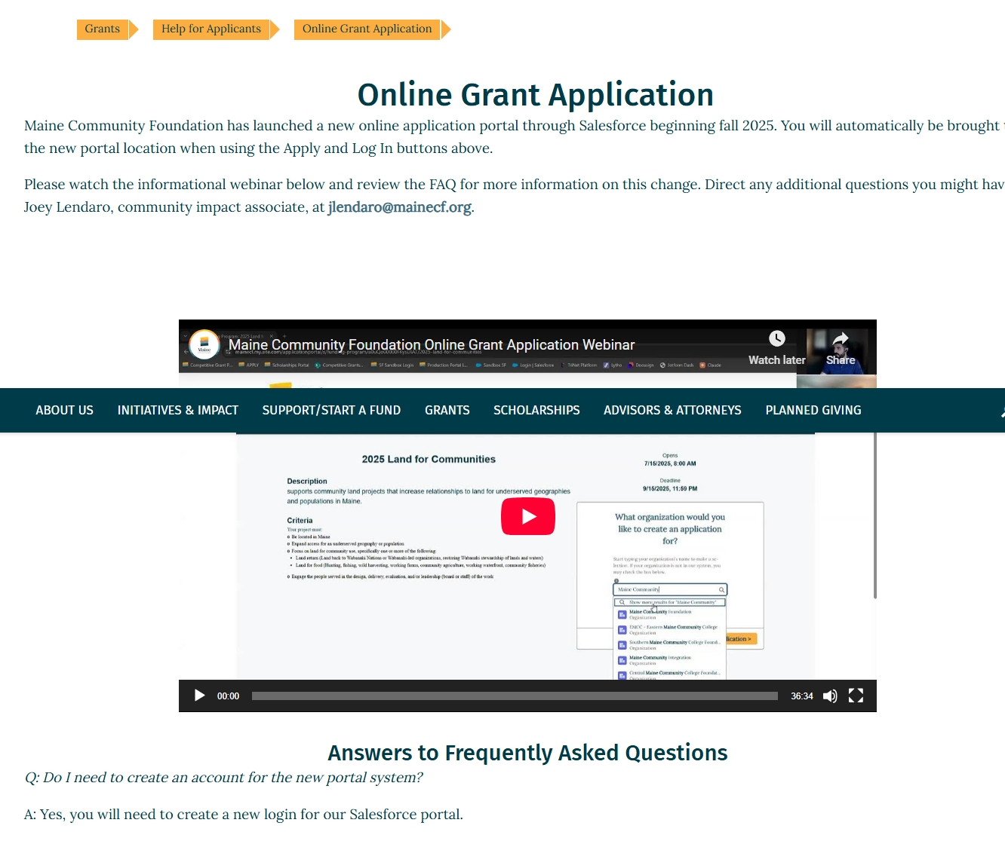
Online Application System

Slide 18

Thank you for joining us today
QUESTIONS?
Gloria Aponte
Community Partner
Photo Credit: Maine Women’s Lobby Education Fund- Girls day at the state house

