Slide 1

Title of Program
Goes Here
Investment Program 2022 Review
February 14, 2023
11 AM EST

Slide 2
Presenters
Deborah Ellwood
President & CEO
Liana Kingsbury
Director, Nonprofit Agency Funds
Brendon Reay
Vice President, Investments

Slide 3
Questions
Please use the Q & A feature to ask questions during the webinar.
After the webinar, please contact:
Brendon Reay: breay@mainecf.org
Liana Kingsbury: lkingsbury@mainecf.org

Slide 4
2022 at MaineCF
New leadership
Updated Mission
New strategic plan

Slide 5
About MaineCF
Mission: To bring people and resources together to build a better Maine.
Vision: Maine is a vibrant and equitable place where people and communities thrive
Values:
  Integrity – we earn trust by being honest and open in everything we do
  Respect – we treat everyone with dignity and civility
  Stewardship – we manage the resources entrusted to us responsibly
  Equity – we promote just and fair access to opportunities for all people
  Collaboration – we work with others to achieve common goals
We share your passion for Maine.

Slide 6
Our Roadmap
Three Pillars of Work
Strengthening Operations and Aligning the Organization
Driving Greater Impact
Mobilizing Philanthropic Resources

Slide 7
Working with MaineCF

Slide 8

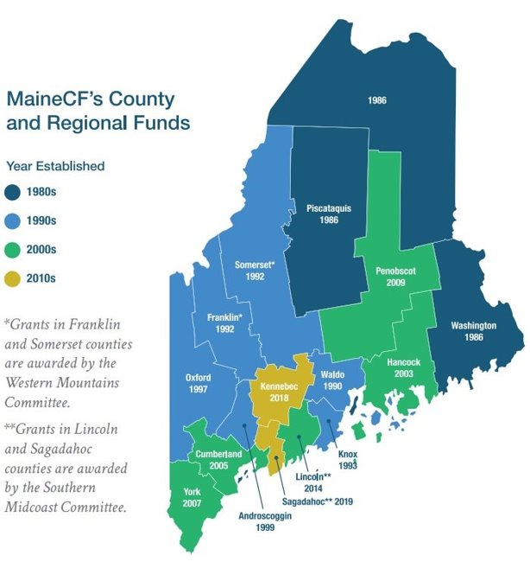
Impact of Grantmaking
Total Awarded in 2022 $59 million
$43M in donor advised grants, including $1.3M in Giving Together grants from 58 different DAFs
$4.9M awarded to grant applicants from every county and a variety of interest areas
$3.9M distributed back to agency fund partners to help further their mission
$3.6M to beneficiaries of designated endowments managed by MaineCF
$2.7M in scholarship support to aspiring graduates and adult-learners
$1.3M towards direct support of community needs and statewide initiatives

Slide 9
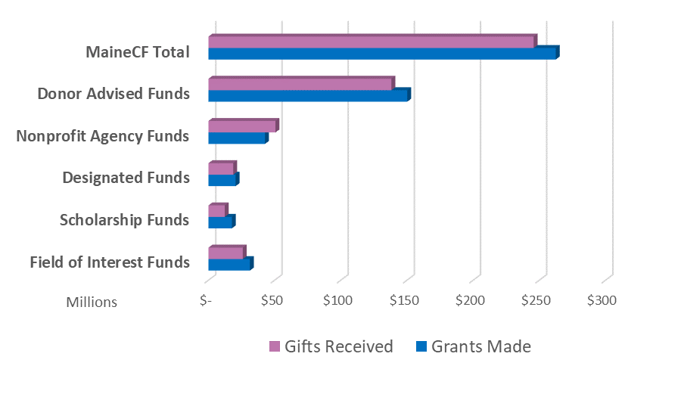
Grants and Gifts
2018 - 2022
$262.4M in grants made over the past 5-years

Slide 10
Growth of Assets

Slide 11
Investment Performance (annualized, as of 12/31/22)

Slide 12
2022 Summary
Market
Performance
S&P 500
1Q-22
2Q-22
3Q-22
4Q-22
2022 was a challenging year, with the war in Ukraine and central banks’ battle against inflation being primary contributors to uncertainty.
Value stocks outperformed growth stocks. High starting valuations largely explain growth stock returns, and while valuations have corrected, they are still elevated relative to history.
The S&P 500 Index declined 18.1%, the Russell 1000 Growth index fell 29.1%, and the Russell 1000 Value index was down 7.6% during 2022.
Value performance has been supported by the relative outperformance of more defensive sectors, such as healthcare, consumer staples, and utilities, along with the strong returns for energy stocks.
During the year, the U.S. dollar rose 8.2% versus a basket of major currencies.
The MSCI EAFE Index fell 14.0%, while the MSCI Emerging Markets Index declined by 19.7%.
Government bond yields jumped in 2022, causing a sharp sell-off in the bond market.
The Bloomberg U.S. Aggregate Bond index declined 13% in 2022—the worst year on record.
The U.S. 10-year Treasury yield rose 273 basis points to 4.24% on October 24th, before falling to 3.88% at the end of December.
The Federal Reserve raised rates by 425 basis points in 2022 and another 25 basis points thus far in 2023 to a range between 4.5% and 4.75%, one of the most aggressive hiking cycles since the 1980s.
10-Year Treasury
Source: Bloomberg and Monticello Associates
Notes:
H2.61’xW4.2
Government bond yields were generally higher this year, and credit spreads wider, weighing heavily on performance.
Commodities were generally negative in the third quarter, driven lower mainly by weaker energy prices.

Slide 13
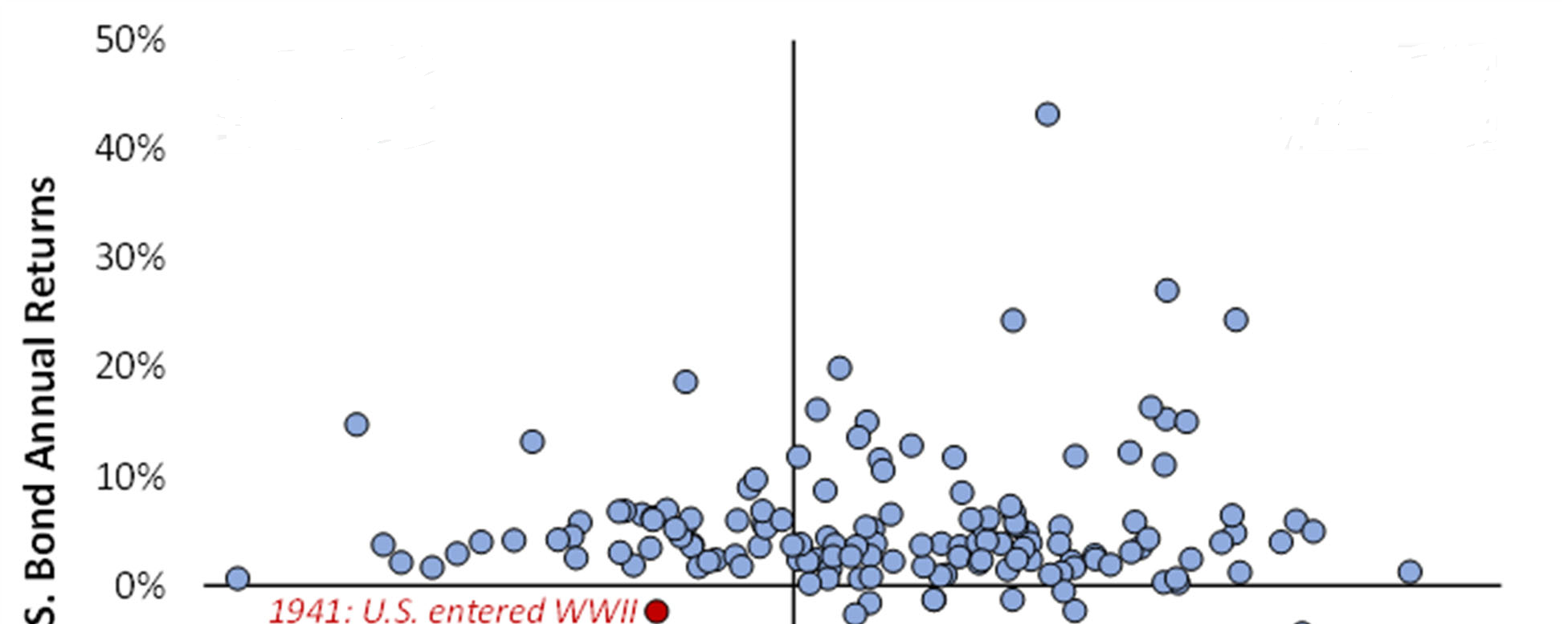
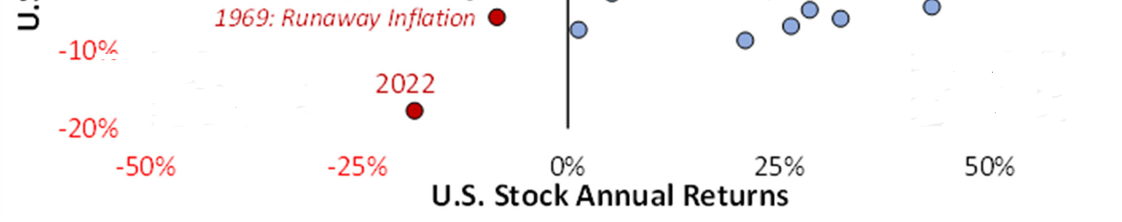
2022 – A Year to Remember Forget
Stock & Bond Performance – 1871 to 2022
Stocks
Bonds
Stocks
Bonds
Stocks
Bonds
Stocks
Bonds

Slide 14
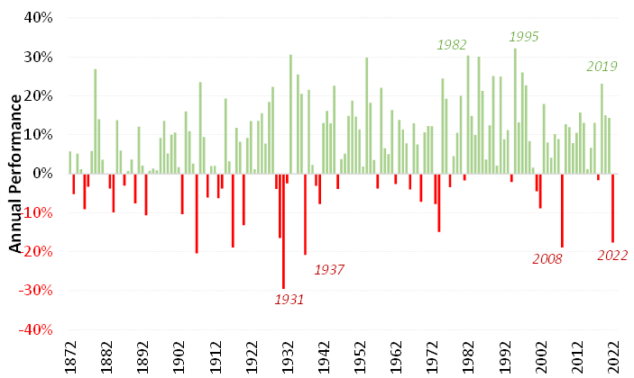
150 years – Annual Performances
Annual 60/40 Blend Portfolio Returns

Slide 15
Asset Allocation

Slide 16
Performance By Asset Class
As of 12/31/2022 | 1-Yr | 3-Yrs | 5-Yrs | 10-Yrs
Total Portfolio | -14.03% | 6.25% | 6.01% | 7.11%
Listed Global Equity | -24.54% | 1.31% | 3.25% | 7.15%
Marketable Alternatives | 0.38% | 7.29% | 6.11% | 6.21%
Private Equity/Venture | -14.08% | 26.88% | 23.40% | 19.54%
Cash & Fixed Income | -4.09% | -0.71% | 0.53% | 0.51%

Slide 17
Return and Risk
MaineCF’s investment objective is to achieve the highest risk-adjusted returns over longer periods of time
Mix of investments aims to return 5+%, net of inflation
Two species of risk:
  Short-term fluctuations in the value of investments (“volatility”). Normal.
  Longer-term risk of permanent loss of capital.
Diversification. Due Diligence.

Slide 18
Comparative Performance
MaineCF vs InvMetrics E&F, as of 12/31/22)

Slide 19
Comparative Performance
(MaineCF vs 56 $100M+ AUM Community Foundations, as of 12/31/22)
Based on survey data provided by the Council on Foundations

Slide 20
Update on Responsible Investing
Statement of Responsible Investing passed in Q2.
Completed review of all current investment managers to assess the portfolio’s ESG awareness
90% of our active managers have an ESG policy (up from 72% in Q3 last year). 100% of our active managers have either integrated ESG factors into their investment process or consider ESG factors as part of their investment process.

Slide 21
Outlook for 2023
We are cautiously pessimistic
  Slightly underweight public equities
  Fully invested in marketable alternatives
  Rotated to short duration FI to pick up some yield
Three views, with data to support each one
  Markets are up 10-15% in 2023
  Markets vacillate between -3 and +3%, finishing slightly negative
  Markets down 10-15%

Slide 22
Bear Market Bottoms – Valuations & Inflation
S&P 500 P/E vs. 10-Yr Trsy. Yield
S&P 500 P/E vs. CPI YoY Change
Market Bottom: Val. & Inflation
Since 1942, the average price-to-earnings ratio for the S&P 500 index is about 12x trailing earnings, while the average 10-Year Treasury yield is 5.5%.
Equity valuations contract during bear market bottoms. While the historical average P/E during bear market bottoms is much lower than the current multiple and the average 10-Year Treasury yield is 209 bps higher, previous market bottoms have occurred with the two securities near their current levels, most notably in 2002.
Inflation, however, was not a problem in 2002. In 2022, the Federal Reserve has repeatedly messaged that it will continue its rate hike path and maintain rates at restrictive territory until inflation is controlled.
The two instances where inflation was higher than today (1942 & 1974) show a market multiple in the mid-single-digits. Currently, the trailing multiple is 18x earnings and CPI is higher than 8%.
Data as of 1/12/2023
Source: Bloomberg, Strategas and Monticello Associates
Notes:
The forward P/E multiple for the S&P 500 retraced from a recent peak of 22.9x to 15.5x through June 30th. However, it rebounded since then to 16.7x as of August 31st and currently trades at above the long-term historical average.
Valuations have fallen more aggressively in more growth-oriented sectors of the market, with the forward P/E multiple for the Russell 1000 Growth index declining from 31.8x to 20.8x as of June 30th. It has since rebounded to 22.3x (as of August 31st).

Slide 23
S&P 500 Index – Earnings Growth Contraction
Earnings-per-Share (EPS) Growth Quarterly Chg. from Year Ago: 2022
EPS Growth Ex-Energy Quarterly Chg. from Year Ago: 2022
Upward EPS Revisions vs. ISM Mfg.
Data as of 12/31/2022
The energy sector has been the most significant contributor to the S&P 500 Index earnings-per-share (EPS) growth in 2022. Higher oil prices in the year's first half contributed to the overall improvement in earnings.
If the energy sector is excluded, the S&P 500 index would have reported a decline in EPS growth of 3.3%, 4.0%, and 5.0% for the first, second, and third quarters, respectively.
During the fourth quarter, the energy sector is also expected to have been the largest contributor to EPS growth.
The ISM Manufacturing index entered contractionary territory in December 2022; there has been a correlation between the manufacturing activity and earnings revisions for the S&P 500 Index.
Contractionary readings for the ISM usually do not bode well for upward earnings revisions.
* Estimates as of 2/3/2023
Source: Bloomberg, Factset, Strategas and Monticello Associates
Notes:
The energy sector currently provides the greatest earnings power. The sector's earnings weight is almost double its market cap weight in the overall index.
Meanwhile, consumer discretionary and real estate are under-earning relative to their market cap weights.

Slide 24
U.S. Yields – The Risk of Recession Has Increased
Treasury Yield Spread: 2-Yr/10-Yr and 3-M/10-Yr
Net Percent of Banks Willing to Lend
Data as of 2/2/2023
Data as of 10/31/2022
A flat yield curve implies a significant economic activity and earnings slowdown, while an inverted yield curve can signal recession.
On December 15th, the 2-year/10-year yield curve reached -80 basis points, its deepest inversion of the last 40 years. The 2-year/10-year yield curve has since eased to -70 basis points, while the 3-month/10-year curve is at -122 basis points.
Bond markets appear to be signaling increased risk of a Federal Reserve policy mistake.
Another data series that is signaling a pending recession is the Senior Loan Officer survey, which shows the willingness of banks to lend; the latest data has turned negative.
A recession occurred in eight of the last nine instances when this happened—the only exception was in the third quarter of 1996.
Source: Bloomberg, Federal Reserve and Monticello Associates
Notes:
There have been six recessions since 1978; on average, the yield curve inverted about twelve months before the recession occurred.
While the 3-month/10-year curve is at -47 basis points, the Fed Funds rate is above both the 10- and 30-year Treasury yields for the first time this cycle.

Slide 25
U.S. Economy – Leading Economic Index
Also Pointing to a Higher Recession Risk
Conference Board: Leading Economic Index (LEI)
LEI / Recession Signals
LEI / U.S. GDP / Recessions
The Conference Board’s Leading Economic Index (LEI) aggregates several indicators of how the economy is doing, including the change in the S&P 500; jobless claims; new manufacturing orders; a yield curve measure; and new housing permits, among others.
The LEI fell by 1.0% in December, following a 1.1% decrease in the prior month. Non-financial variables led to last month’s decline, particularly gauges of demand conditions, consumer expectations, and labor market indicators.
On a year-over-year basis, the LEI index has contracted by 6.0%—yearly contractions higher than 5% have preceded recessions every time since 1961.
Data as of 12/31/2022
Source: Bloomberg and Monticello Associates
Notes:
The LEI and other recession indicators have been sending recessionary signals.

Slide 26
Global Growth – Slowdown
2022 Real GDP Grwth. Forecast* Sel. Regions & Countries
2023 Real GDP Grwth. Consensus Forecast - Daily Progression
2023 Real GDP Grwth. Forecast* Sel. Regions & Countries
The world economy is poised to slow in 2023 as higher interest rates to tackle inflation will likely cause several economies to contract.
The International Monetary Fund (IMF) warned that more than one-third of the world would fall into recession in 2023.
The largest economies are slowing simultaneously, which will most likely translate to a negative trend globally.
*J.P. Morgan Forecasts as of 1/6/2023
Source: Bloomberg, J.P. Morgan and Monticello Associates
Notes:
Global GDP growth is poised to slow down in 2022, driven mainly by the effects of the Omicron variant, supply chain disruptions, labor shortages, and the winding down of government economic support.
Thus far, other than China, most growth forecasts for 2023 are slightly higher or unchanged.
However, most factors decelerating growth are likely to be temporary.

Slide 27
Conclusion
We are and will remain a long-term, vigilant, diversified investor safeguarding and growing the assets you have entrusted to us.

Slide 28
Title of Program
Goes Here
Thank you
We would appreciate your feedback
Brendon Reay, VP Investments
Email: breay@mainecf.org
Direct line: 207-412-2016
Mail: 245 Main St., Ellsworth, ME 04605

Slide 29
MaineCF Investment Committee
Mark Howard, CFA, Chair, Managing Director and Senior Multi-Asset Specialist, BNP Paribas, New York City and Boothbay, Maine
Elizabeth R. Hilpman, Former Chair, Partner, Barlow Partners, New York City, and Woolwich, Maine
Forrest Berkley, Former Chair, retired Partner, Grantham, Mayo, VanOtterloo & Co., LLC, Concord, Massachusetts, and Northeast Harbor, Maine
John B. Sullivan, Former Chair, President, Portland Global Advisors, Portland, Maine
Martha Dumont, retired Director of Research, Credit Sights, New York, NY. and former Director of Global Fixed Income Research at Lehman Brothers, Falmouth, Maine
Brooke Parish, President and Partner, Corvid Peak Capital Management, New York City and Castine, Maine

Slide 30
Independent Investment Consultant
Role of investment consultant
  MaineCF staff and Investment Committee work closely with an independent investment consultant to monitor investment manager performance and assist in manager selection
  Investment consultant also provides extensive analytical and comparative reporting to assist staff and the committee with its decision-making
Consultant - Monticello Associates
  Independent asset management consulting firm providing non-discretionary investment advisory services
  Founded in 1992 with a focus on endowment and foundation clients and high net worth families
  Headquarters in Denver with offices in Cleveland and Boston
  Grown into one of the country’s leading asset management consulting firms working with many prominent community foundations, museums, hospitals, schools, and families across the U.S.
MaineCF’s primary contact at Monticello: Andrew Terborgh, Managing Director

