Slide 1
Strategies for Digital Ecosystem Development in Rural America
Matt Dunne
www.ruralinnovation.us
matt.dunne@ruralinnovation.us
@ruralinno
November 2019

Slide 2
My background
VT State Representative & Senator for 10+ years
Enacted VT’s first broadband grant program
National Director
Led PowerUP initiative to bridge rural digital divide
Founder
Focused on promoting economic development in Rural America
Rural entrepreneur
Director of Marketing at Logic Associates; helped grow company to over 100 employees
Director of Community Affairs
Based in VT, led all US philanthropy and engagement for Google FIber rollout

Slide 3
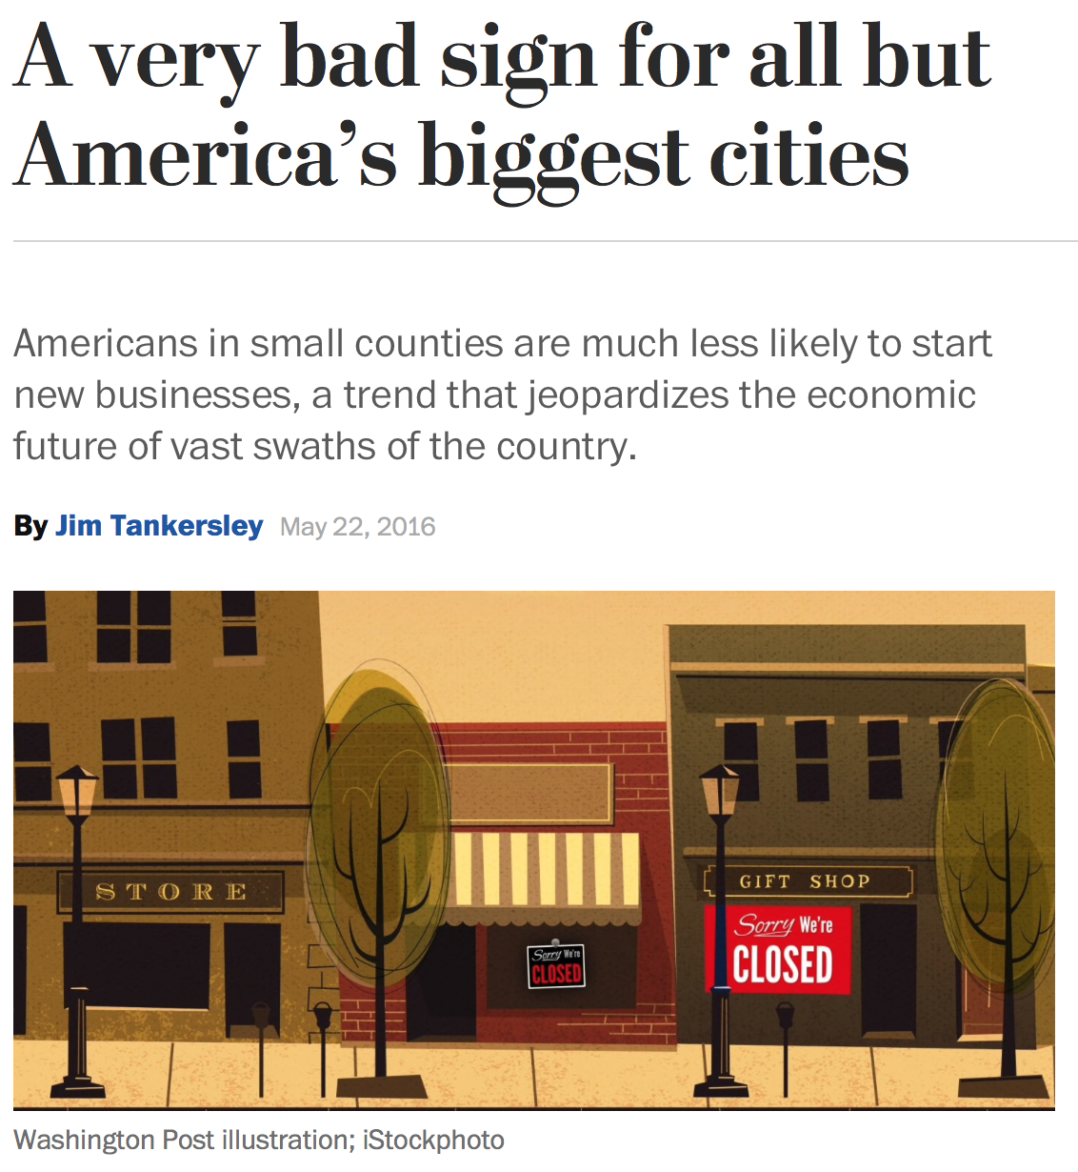
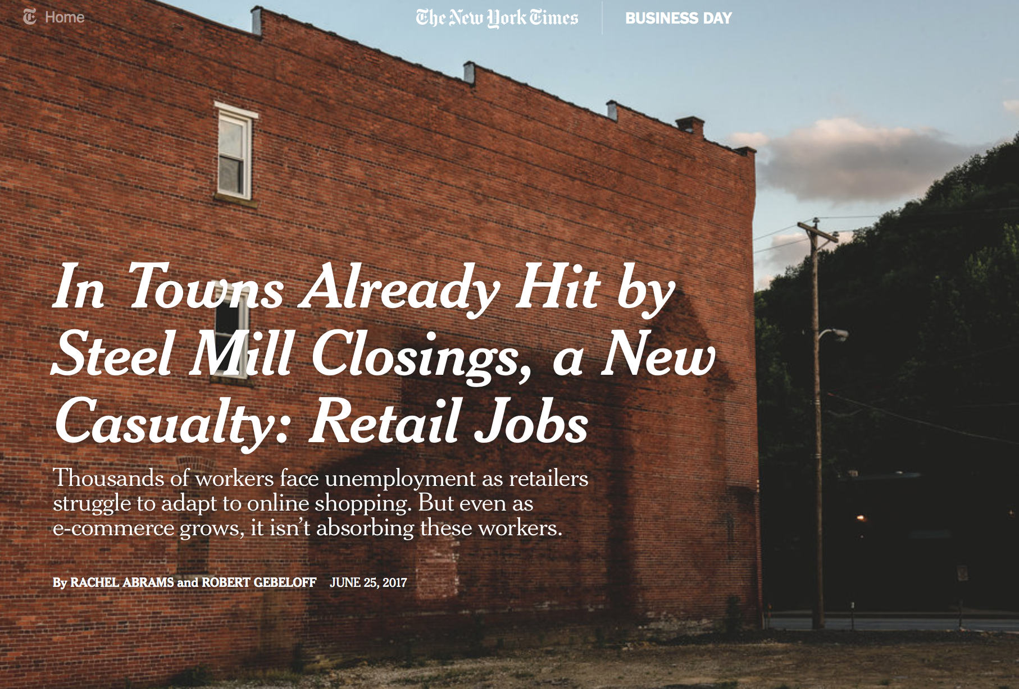
The US is struggling with a rural opportunity gap . . .

Slide 4
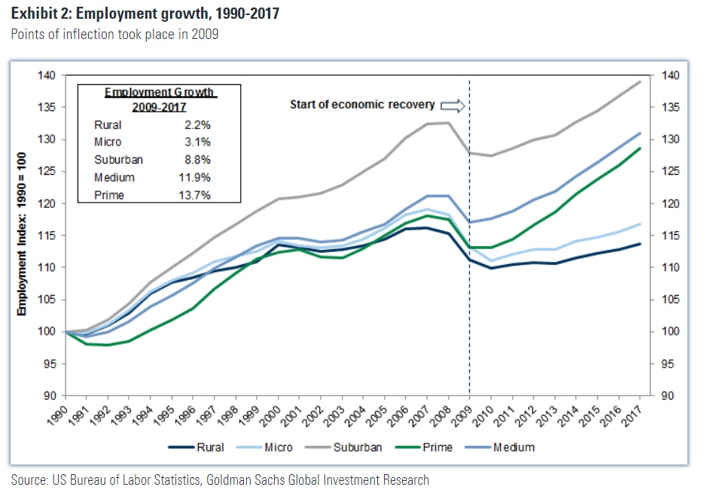
. . . that continues to widen
Employment growth by geography 1990-2017
Suburban
Medium-sized cities
Large cities
Micropolitan areas
Rural
Notes:
Source: BLS Data compiled by Goldman Sachs Investment Research
https://ricochet.com/581933/archives/5-charts-on-the-economic-gaps-between-urban-and-rural-america/

Slide 5
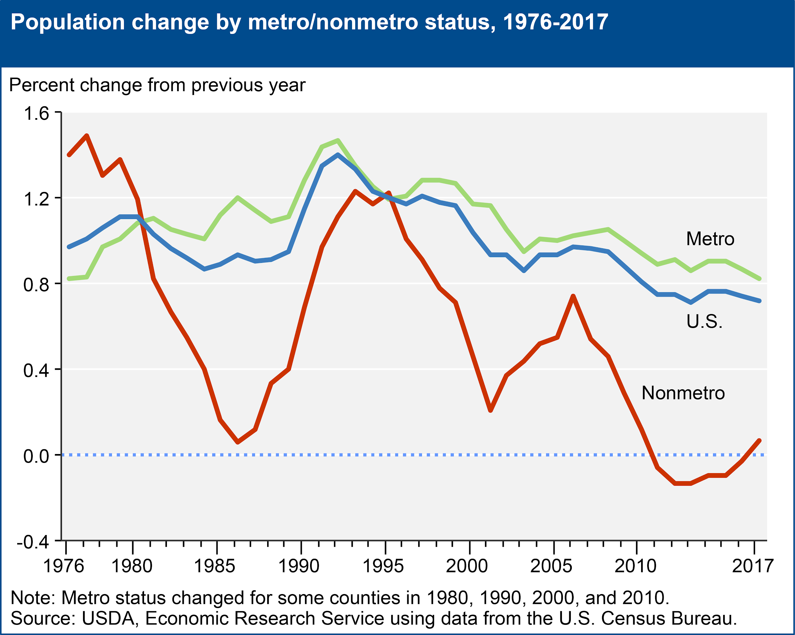
The divide has serious repercussions for rural areas
COLLEGE DEBT Federal Reserve Bank study shows rural college graduates with student debt much more likely to move to urban areas than college graduates without debt. EDUCATIONAL LEVELS 47% less likely to have a bachelor's degree or higher in non-metro areas.
OPIOID CRISIS Drug-related deaths are 45% higher in rural areas.

Slide 6
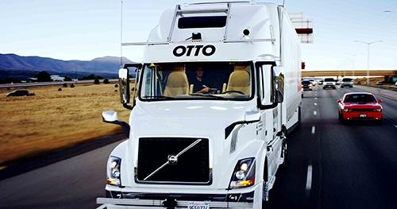
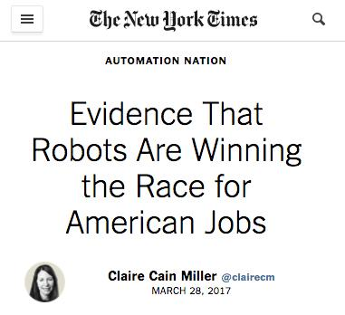
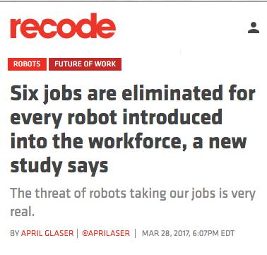
And the future of current rural work is GRIM
OTTO (owned by Uber): First driverless truck run in Colorado October 2016.
“The researchers said they were surprised to see very little employment increase in other occupations to offset the job losses in manufacturing. That increase could still happen, they said, but for now there are large numbers of people out of work, with no clear path forward — especially blue-collar men without college degrees.” New York Times, March 28, 2017
“...smaller, more rural communities [are] significantly more exposed to automation-driven task replacement”
Brookings Institution, 2019

Slide 7
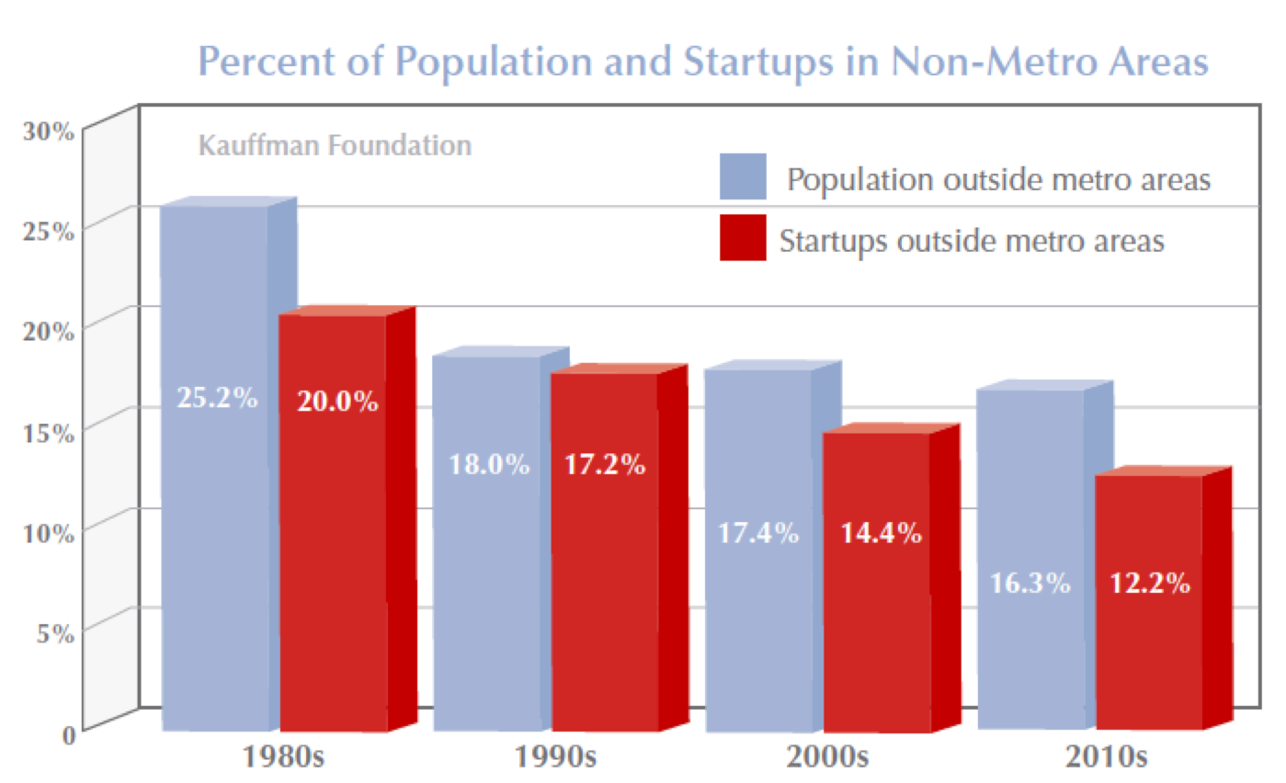
As is the future of rural entrepreneurship . . .
WHY IS THIS HAPPENING?
Inadequate infrastructure 39% of rural lacks 25/4 Mbps vs. 4% of urban
Concerns over density of talent and deal flow
RESULT: less than 1% of VC investments go to entrepreneurs in rural areas.

Slide 8
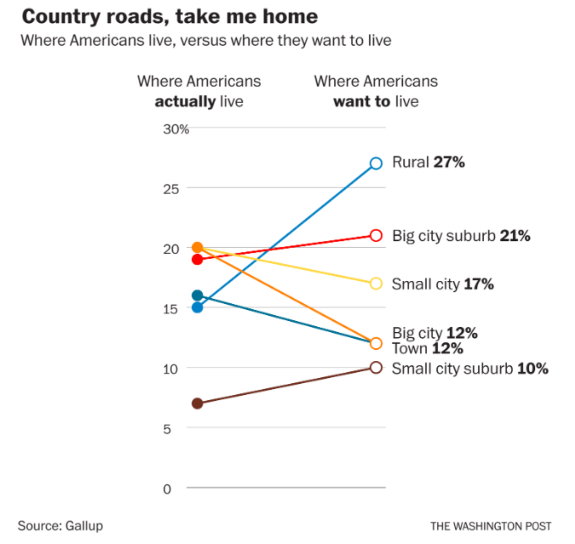
However, market forces signal new rural opportunities
More than 2,500 rural towns have access to fiber internet, representing more than 10 million rural Americans — a distributed workforce equal to the new economy hubs of New York City, San Francisco, and Boston combined.
More than 2,800 rural census tracts now offer robust investment incentives through the Opportunity Zone program. Investments will be deployed starting late 2019.

Slide 9
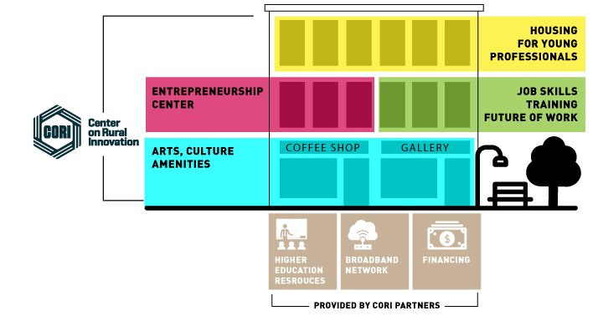
An integrated ecosystem approach is needed to rise above these challenges - the innovation hub

Slide 10
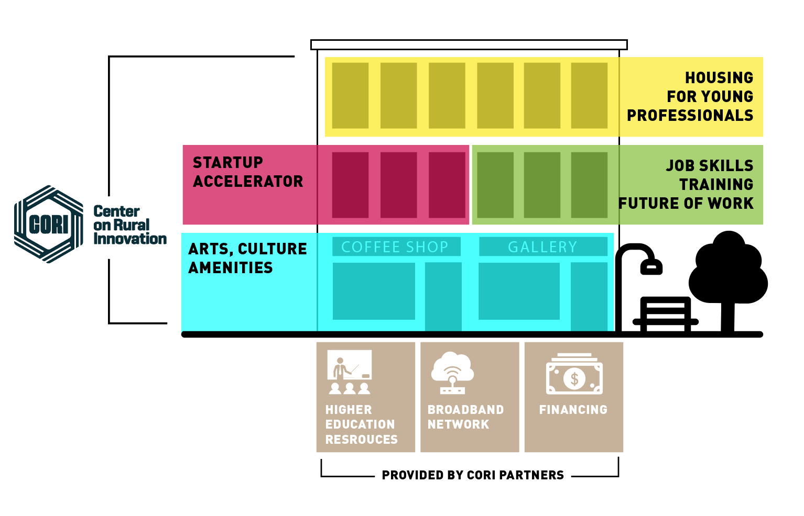
We believe success requires virtual scale across the rural US
INNOVATION HUB
INNOVATION HUB
INNOVATION HUB
INNOVATION HUB
Standardization of model allows for faster deployment, ready-made trust with employers, VCs, etc
Network provides more dealflow, better business development
Resources and opportunities can be shared to strengthen outcomes
Collective national profile allows towns to better compete

Slide 11
We launched the Rural Innovation Initiative in 2018 to help create a nationwide community of innovation hubs
130+ communities applied to be part of our initial cohort
Wide variety of geographies and community profiles
All selected communities had fiber¹
Looking to expand to another 10+ communities this year
Independence, OR
Traverse City, MI
Red Wing, MN
Cape Girardeau, MO
Emporia, KS
Wilson, NC
Pittsburg, KS
Pine Bluff, AR
1. Some communities were completing FTTH projects
11

Slide 12
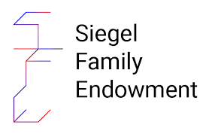
The Rural Innovation Initiative is helping connect communities with our broad network of national partners
Reid Hoffman
LinkedIn Co-Founder

Slide 13
It also links communities to CORI resources and initiatives
Capacity building for organizations
Grant writing and fundraising support
OZ Seed Fund
Peer-to-peer learning
Rural Innovation Network
Entrepreneur coaching & mentorship
Rural Opportunity Map
Broadband technical assistance
Distributed Work

Slide 14
Our first group of communities has already begun to see real success
3
Communities awarded
EDA i6 grant
$6M+
In local i6 matching funds raised by 8 communities¹
8
Successful community planning processes
1
Epic convening in Springfield, VT
1. Across all i6 applicants - 3 communities received grant. Some matching funds may be contingent upon grant award

Slide 15
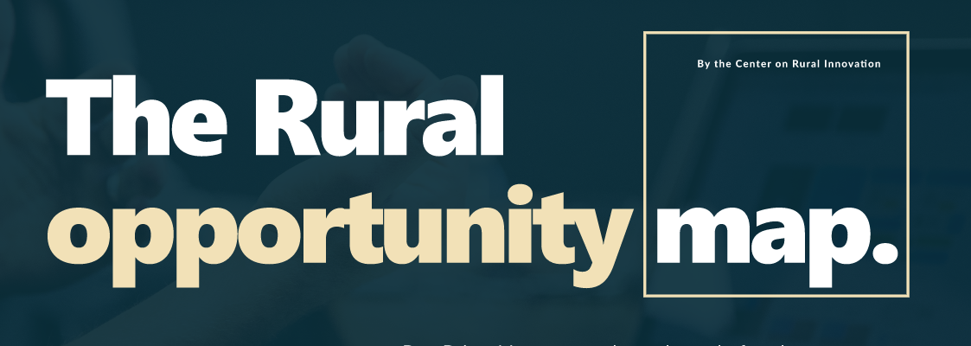
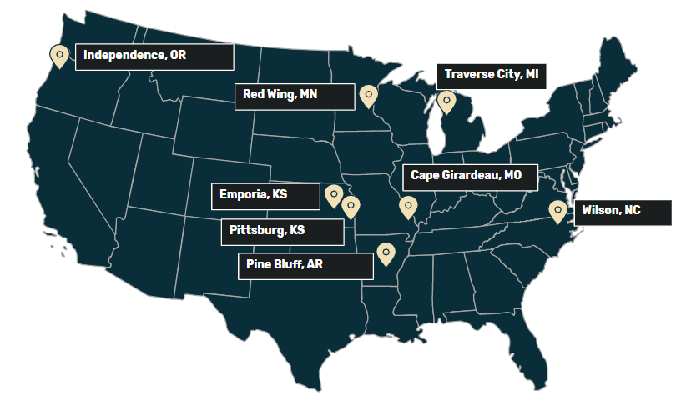
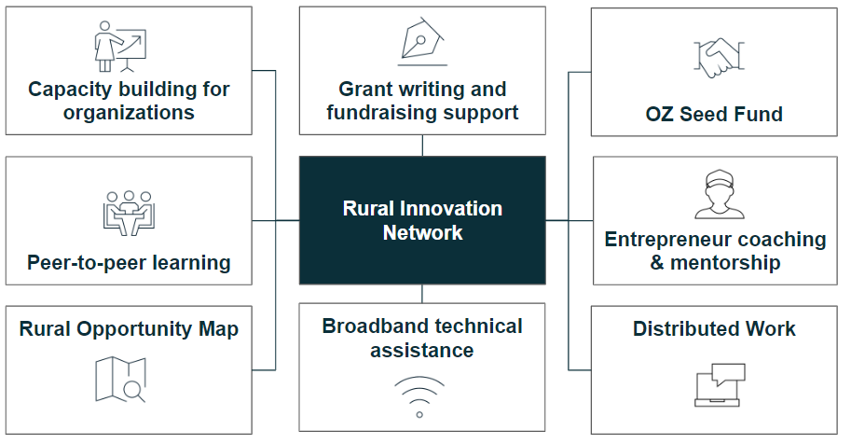
More exciting developments are just around the corner
Rural Opportunity Map
CORI Innovation Fund
Cohort II of Rural Innovation Initiative
USDA RCDI Broadband Agreement
Rural Innovation Network
Identifying opportunity across Rural America
Investing in rural Opportunity Zone startups
Bringing 10 more communities into the network
Providing broadband planning services to 6+ communities
Launch of Rural Innovation Network platform and early resources
Beta launch last month
Late September
October -
December
Winter 2019–2020
Fall 2019 though mid-2020

Slide 16
But there is still a lot of work to do...
Getting Real About Rural America
Nobody knows how to reverse the heartland’s decline
“When we think of America, we shouldn’t think rural”
Notes:
https://www.nytimes.com/2019/03/18/opinion/rural-america-economic-decline.html Paul Krugman, Getting Real About Rural America, March 18, 2019
https://www.washingtonpost.com/opinions/when-we-think-of-america-we-shouldnt-think-rural/2019/06/09/e1bb7b08-8ad7-11e9-adf3-f70f78c156e8_story.html?utm_term=.5ec3157d5b84 When we think of America, we shouldn’t think rural, Kate Cohen, June 9, 2019

Slide 17
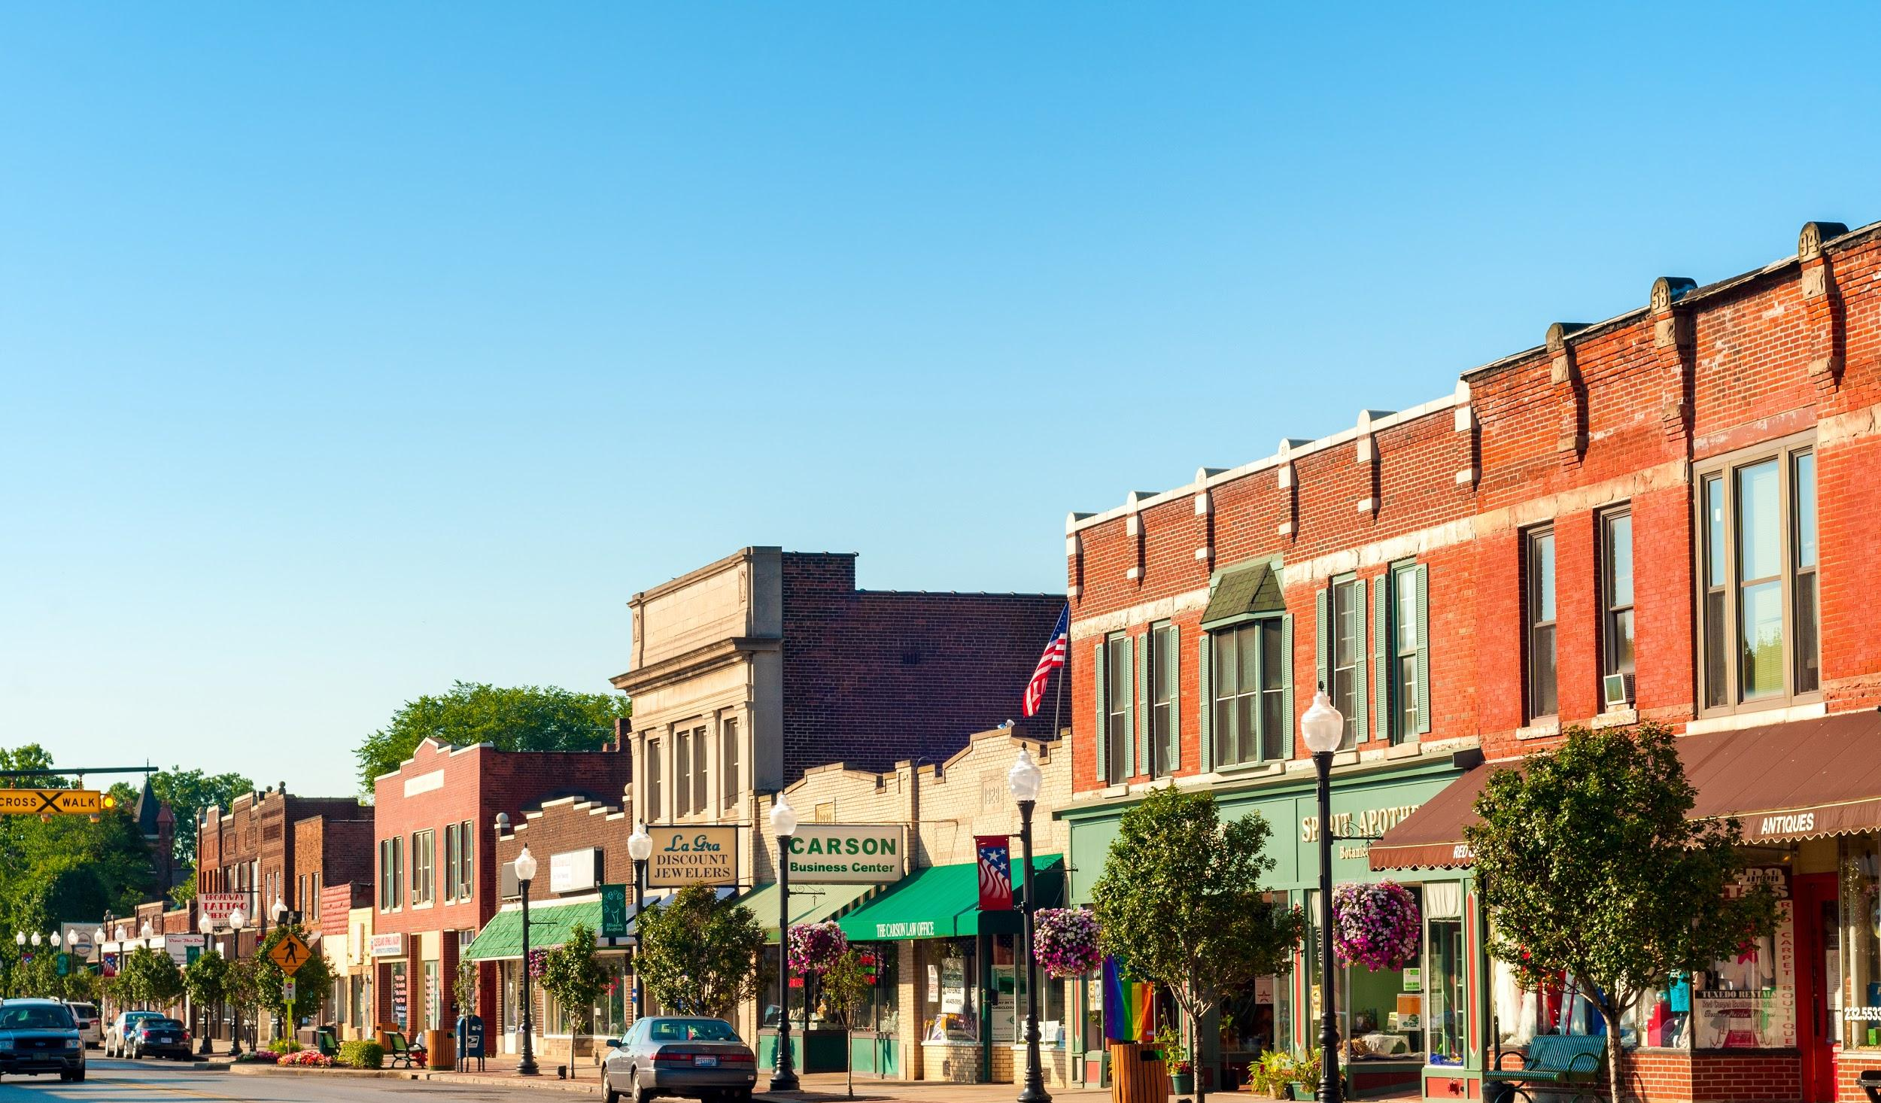
We can bring 21st century
prosperity to rural America.

